Slide 1
Financial advice for growing your farm business
Christine arezzi
professional financial advisor
lavender farmer, Bluewater lavender farm

Slide 2

Agenda
Growing Sustainably
Understanding Financing
Smart Decisions
Building Revenue Streams
Scaling Labour

Slide 3

Growth stages
Small Scale: 1-5 acres, owner-operated, limited equipment, farmers markets + online + on-farm sales
Medium Scale: 5-20 acres, some hired help, mechanized harvesting/processing, wholesale + retail + agritourism
Large Scale: 20+ acres, full staff, dedicated retail location, strong brand, wholesale contracts + agritourism

Slide 4
Financial foundations for all stages
Separate personal and business finances
Track all expenses
Know your true profit margins
Build a cash reserve (minimum 3-6 months)

Slide 5

Understanding
Credit and debt
Good Debt: Generates revenue, increases efficiency, scales production
Bad Debt: Funds non-essential expenses, doesn’t increase income, high-interest with no return on investment
Rule: Only take on debt that increases future cash flow

Slide 6
Credit cards
Term loans
Lines of credit
Agricultural loans
Reverse mortgages
Types of financing

Slide 7

Credit cards
Pros: easy to access, useful for short-term expenses
Cons: high interest, dangerous for long-term debt
Best for: supplies, emergency repairs

Slide 8

Term loans
Pros: lower interest, predictable payments
Cons: require strong credit and documentation
Best for: equipment, real estate, expansion projects

Slide 9
Lines of credit
Pros: flexible, only pay interest on what you use
Cons: can encourage overspending
Best for: seasonal cash flow gaps, payroll during busy season

Slide 10
Agricultural loans
Pros: lower down-payment, farmer-friendly terms
Cons: more paperwork, slower approval
Best for: beginning farmers, land purchases, infrastructure

Slide 11
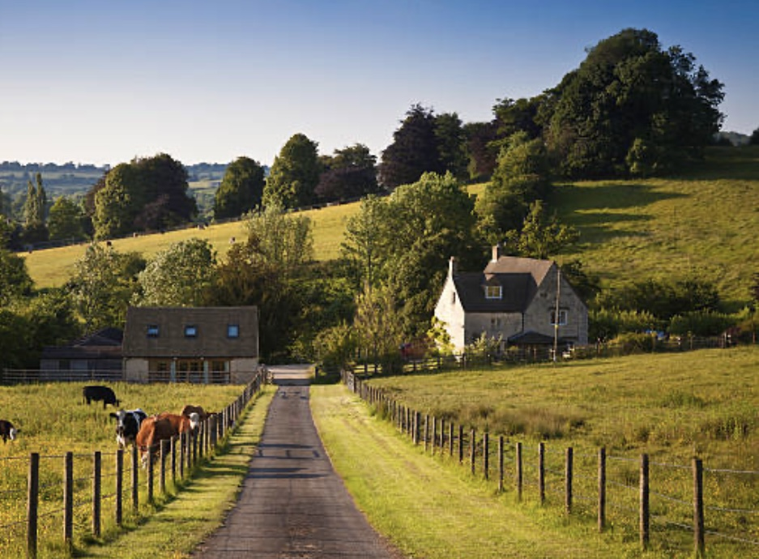
Reverse mortgages
Pros: receive money from home equity without selling the property, no regular payments
Cons: must repay when you move or sell, may outlive term if taken early, interest accumulates the longer you don’t pay
Best for: age 55+, farm is primary residence, able to pay home ownership-related costs

Slide 12
What do Lenders look for?
How to qualify for financing

Slide 13
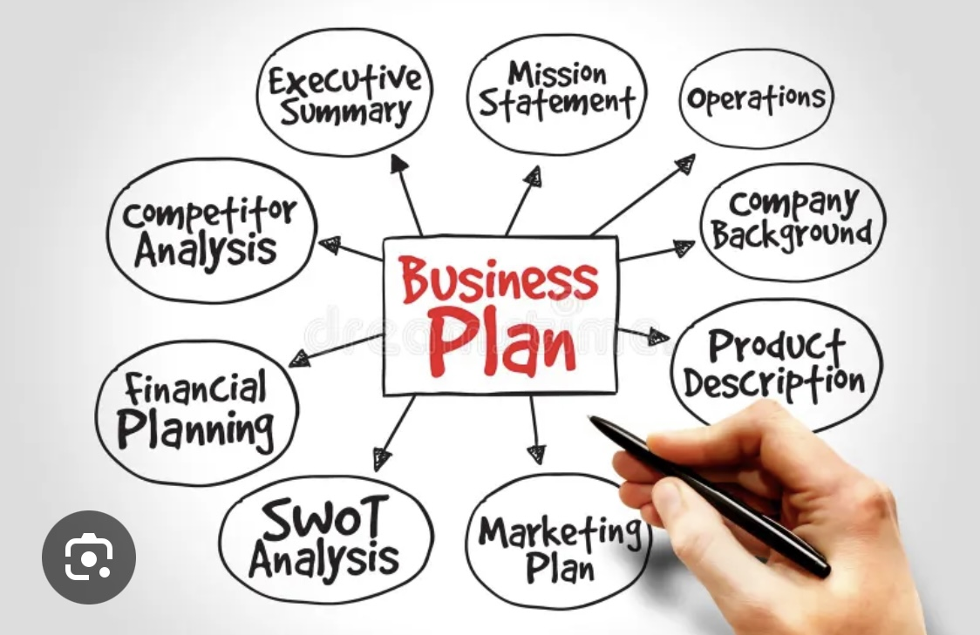
Lenders look for:
Good credit score (650+)
2-3 years of financial records
Business Plan
Cash flow projections
Debt-to-income ratio

Slide 14
Tips
Start building business credit early
Develop a relationship with your bank
Consider working with a financial advisor
Use a business chequing account with low/no fees
Set up a business credit card and use wisely
Pay vendors on time

Slide 15
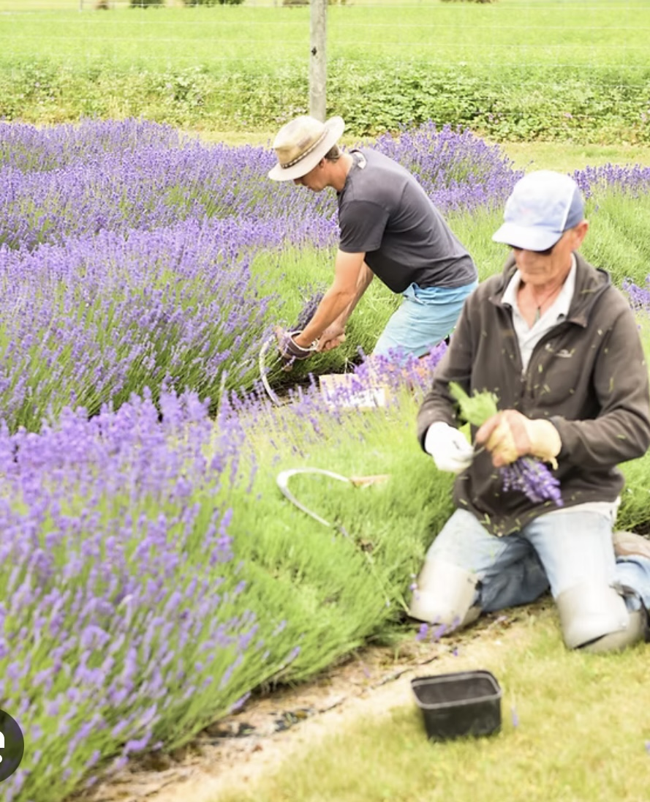
Scaling equipment purchases
early stage
Hand harvesting
Shared or rented distillation
Used equipment

Slide 16
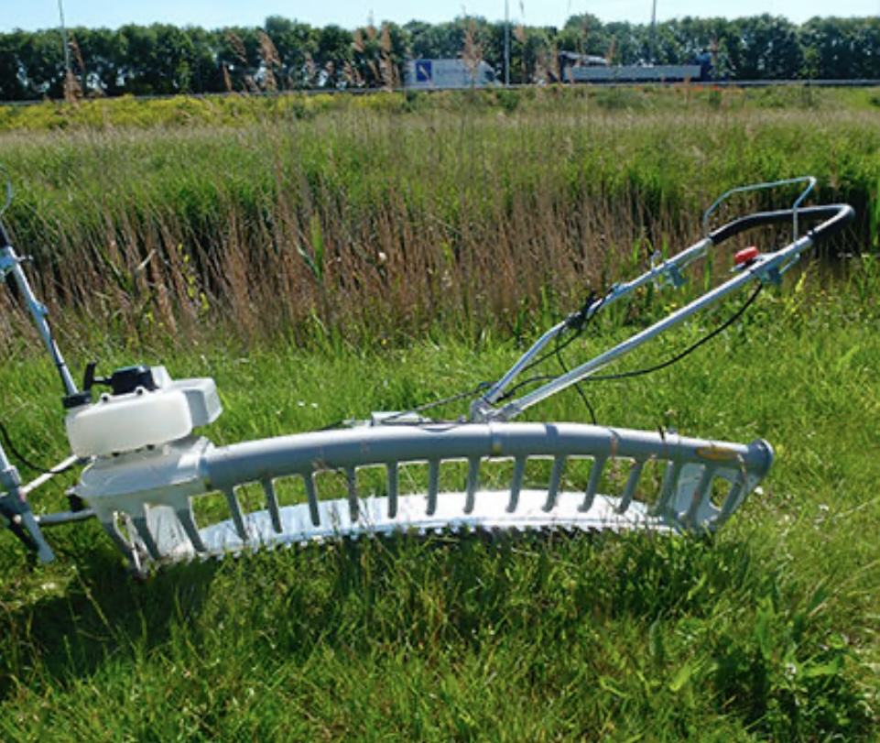
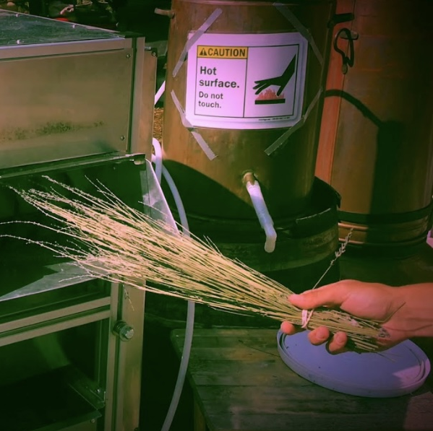
Scaling equipment purchases
Medium stage
Mechanical harvesters
Debudders
Small distillation equipment

Slide 17
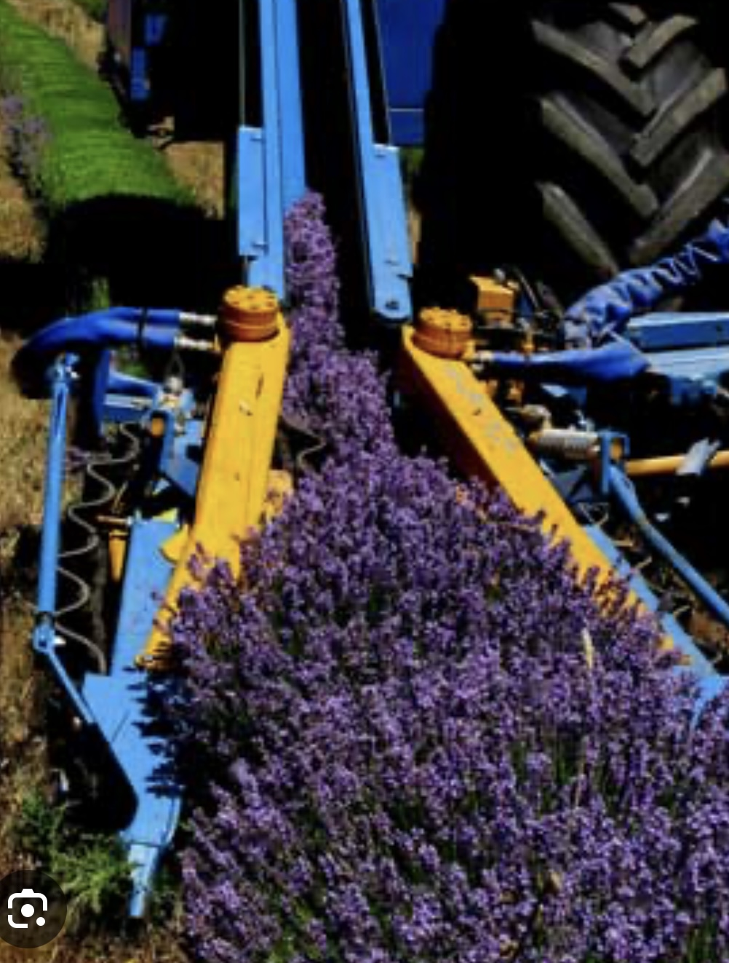
Scaling equipment purchases
Large stage
High-capacity harvesters
In-house large distillation and packaging equipment

Slide 18
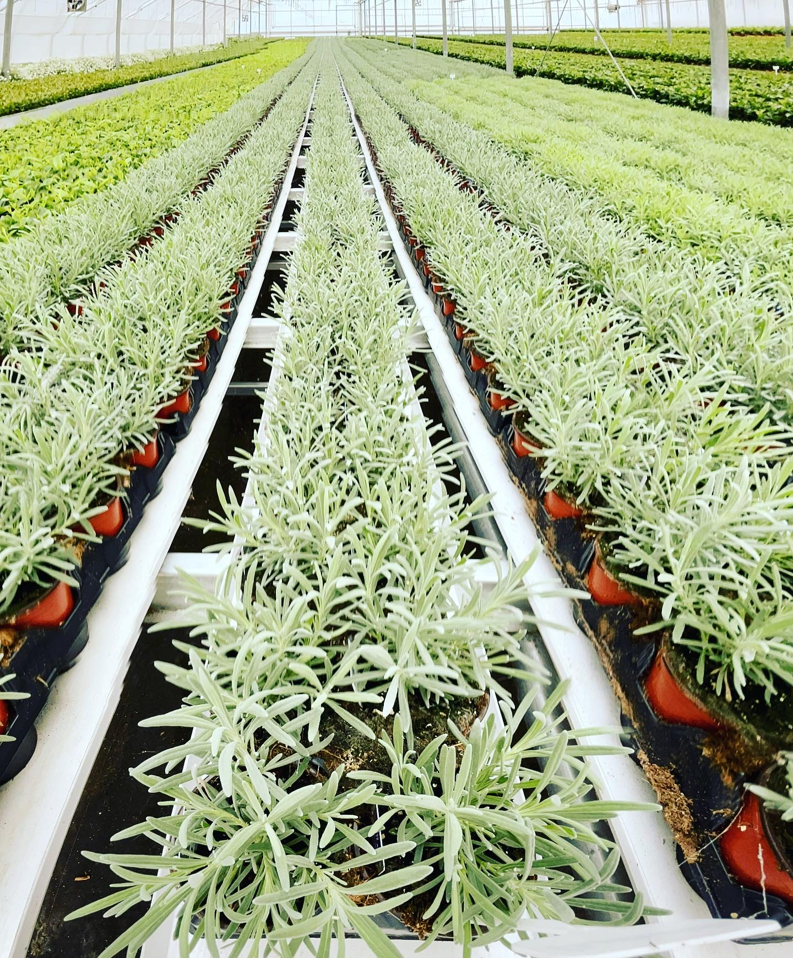
Buying equipment tips
Buy used first when possible
Compare labour savings vs. loan payment
Lease = flexibility
Buy = long-term savings
Scheduled maintenance to protect investment

Slide 19

Renting vs buying
Retail store expansion

Slide 20
Renting
Pros: lower up-front cost, flexibility, faster entry
Cons: no equity, rent increases, less control
Best for: testing a new market, medium-scale farms

Slide 21
Buying
Pros: builds equity, stable monthly payments, property appreciation
Cons: large down-payment, maintenance responsibility
Best for: established farms, long-term retail strategy

Slide 22
Tips for commercial real estate
Location matters more than size
Look for: foot traffic and visibility, parking
Understand zoning and rules
Startup costs
Complimentary businesses
Plan for expansion space

Slide 23

Creating a successful retail store
Focus on the experience, not just products
Tell your farm story
Offer workshops
Regular events
Upsell with gift sets
Train staff on product education

Slide 24
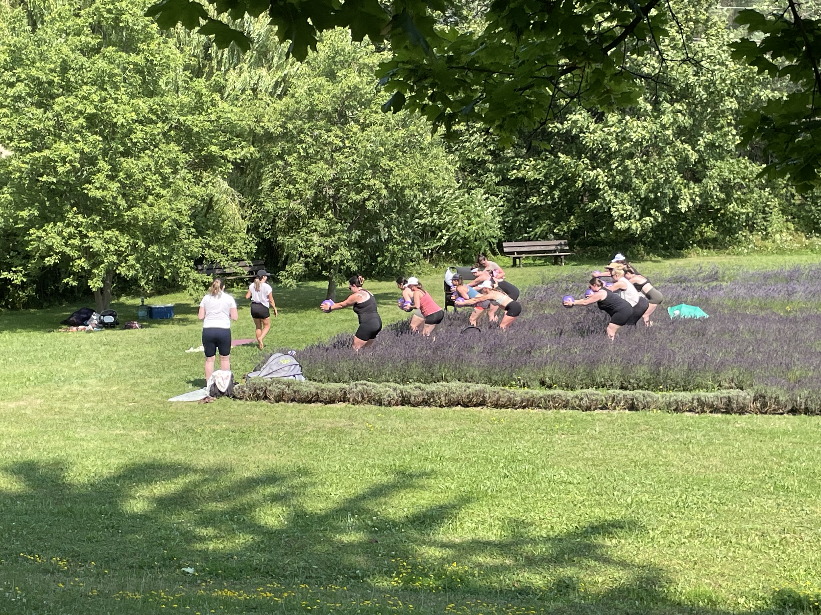
Agritourism - why it works
High-margin revenue
Builds brand loyalty
Drives retail sales
Seasonal flexibility
Try: U-Pick, Farm Tours, Photo Sessions, Classes and Workshops

Slide 25
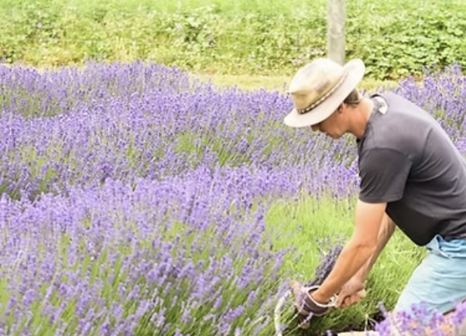
Hiring employees
Stage 1
Volunteers (students, mature gardeners)
Part-time seasonal
Minimize payroll costs

Slide 26
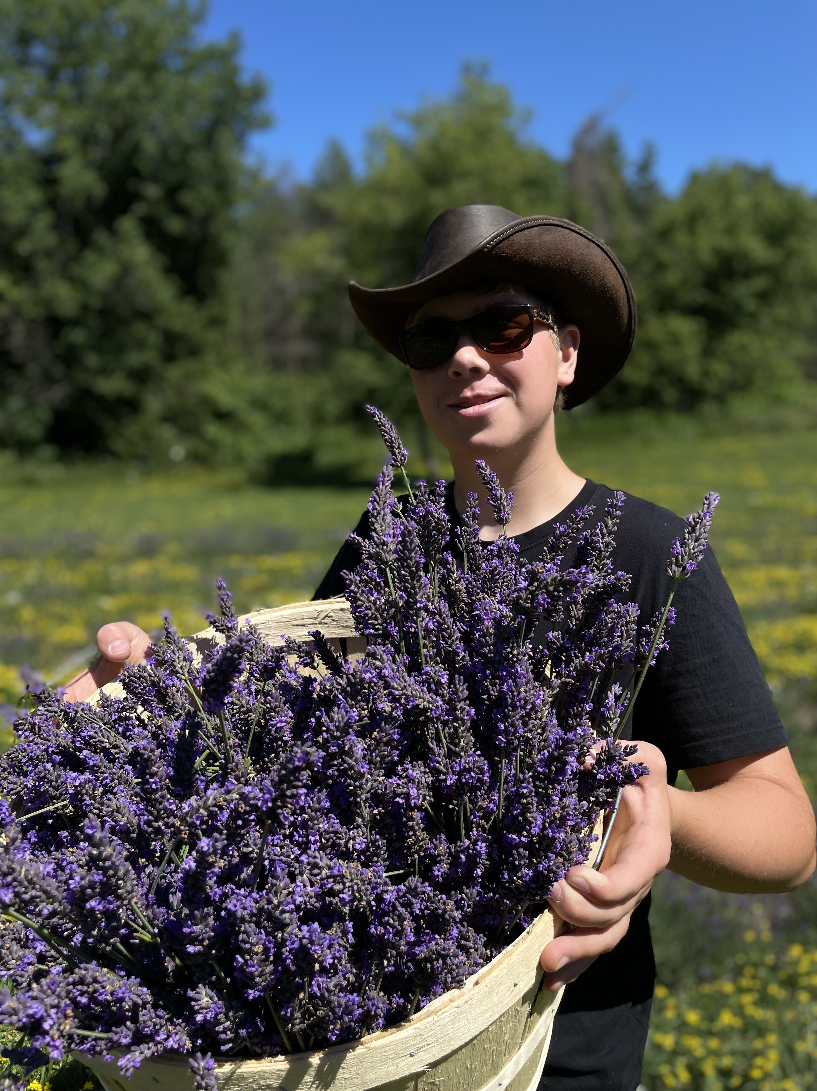
Hiring employees
Stage 2
Seasonal help, part-time
Retail and harvest support
Flexible scheduling
Cross-training

Slide 27

HIRING EMPLOYEES
STAGE 3 + 4
Stage 3
Full-time seasonal
Retail managers in peak season
Stage 4
Full-time, year-round
Retail Manager
Farm Lead

Slide 28
Managing labour costs wisely
Track labour costs
Cross-train employees
Use seasonal contracts
Invest in labour-saving equipment
Build a strong workplace culture to reduce turnover

Slide 29
Key growth principles
Plan 3-5 years ahead
Scale business, not just acreage
Grow revenue before growing expenses
Protect cash flow

Slide 30
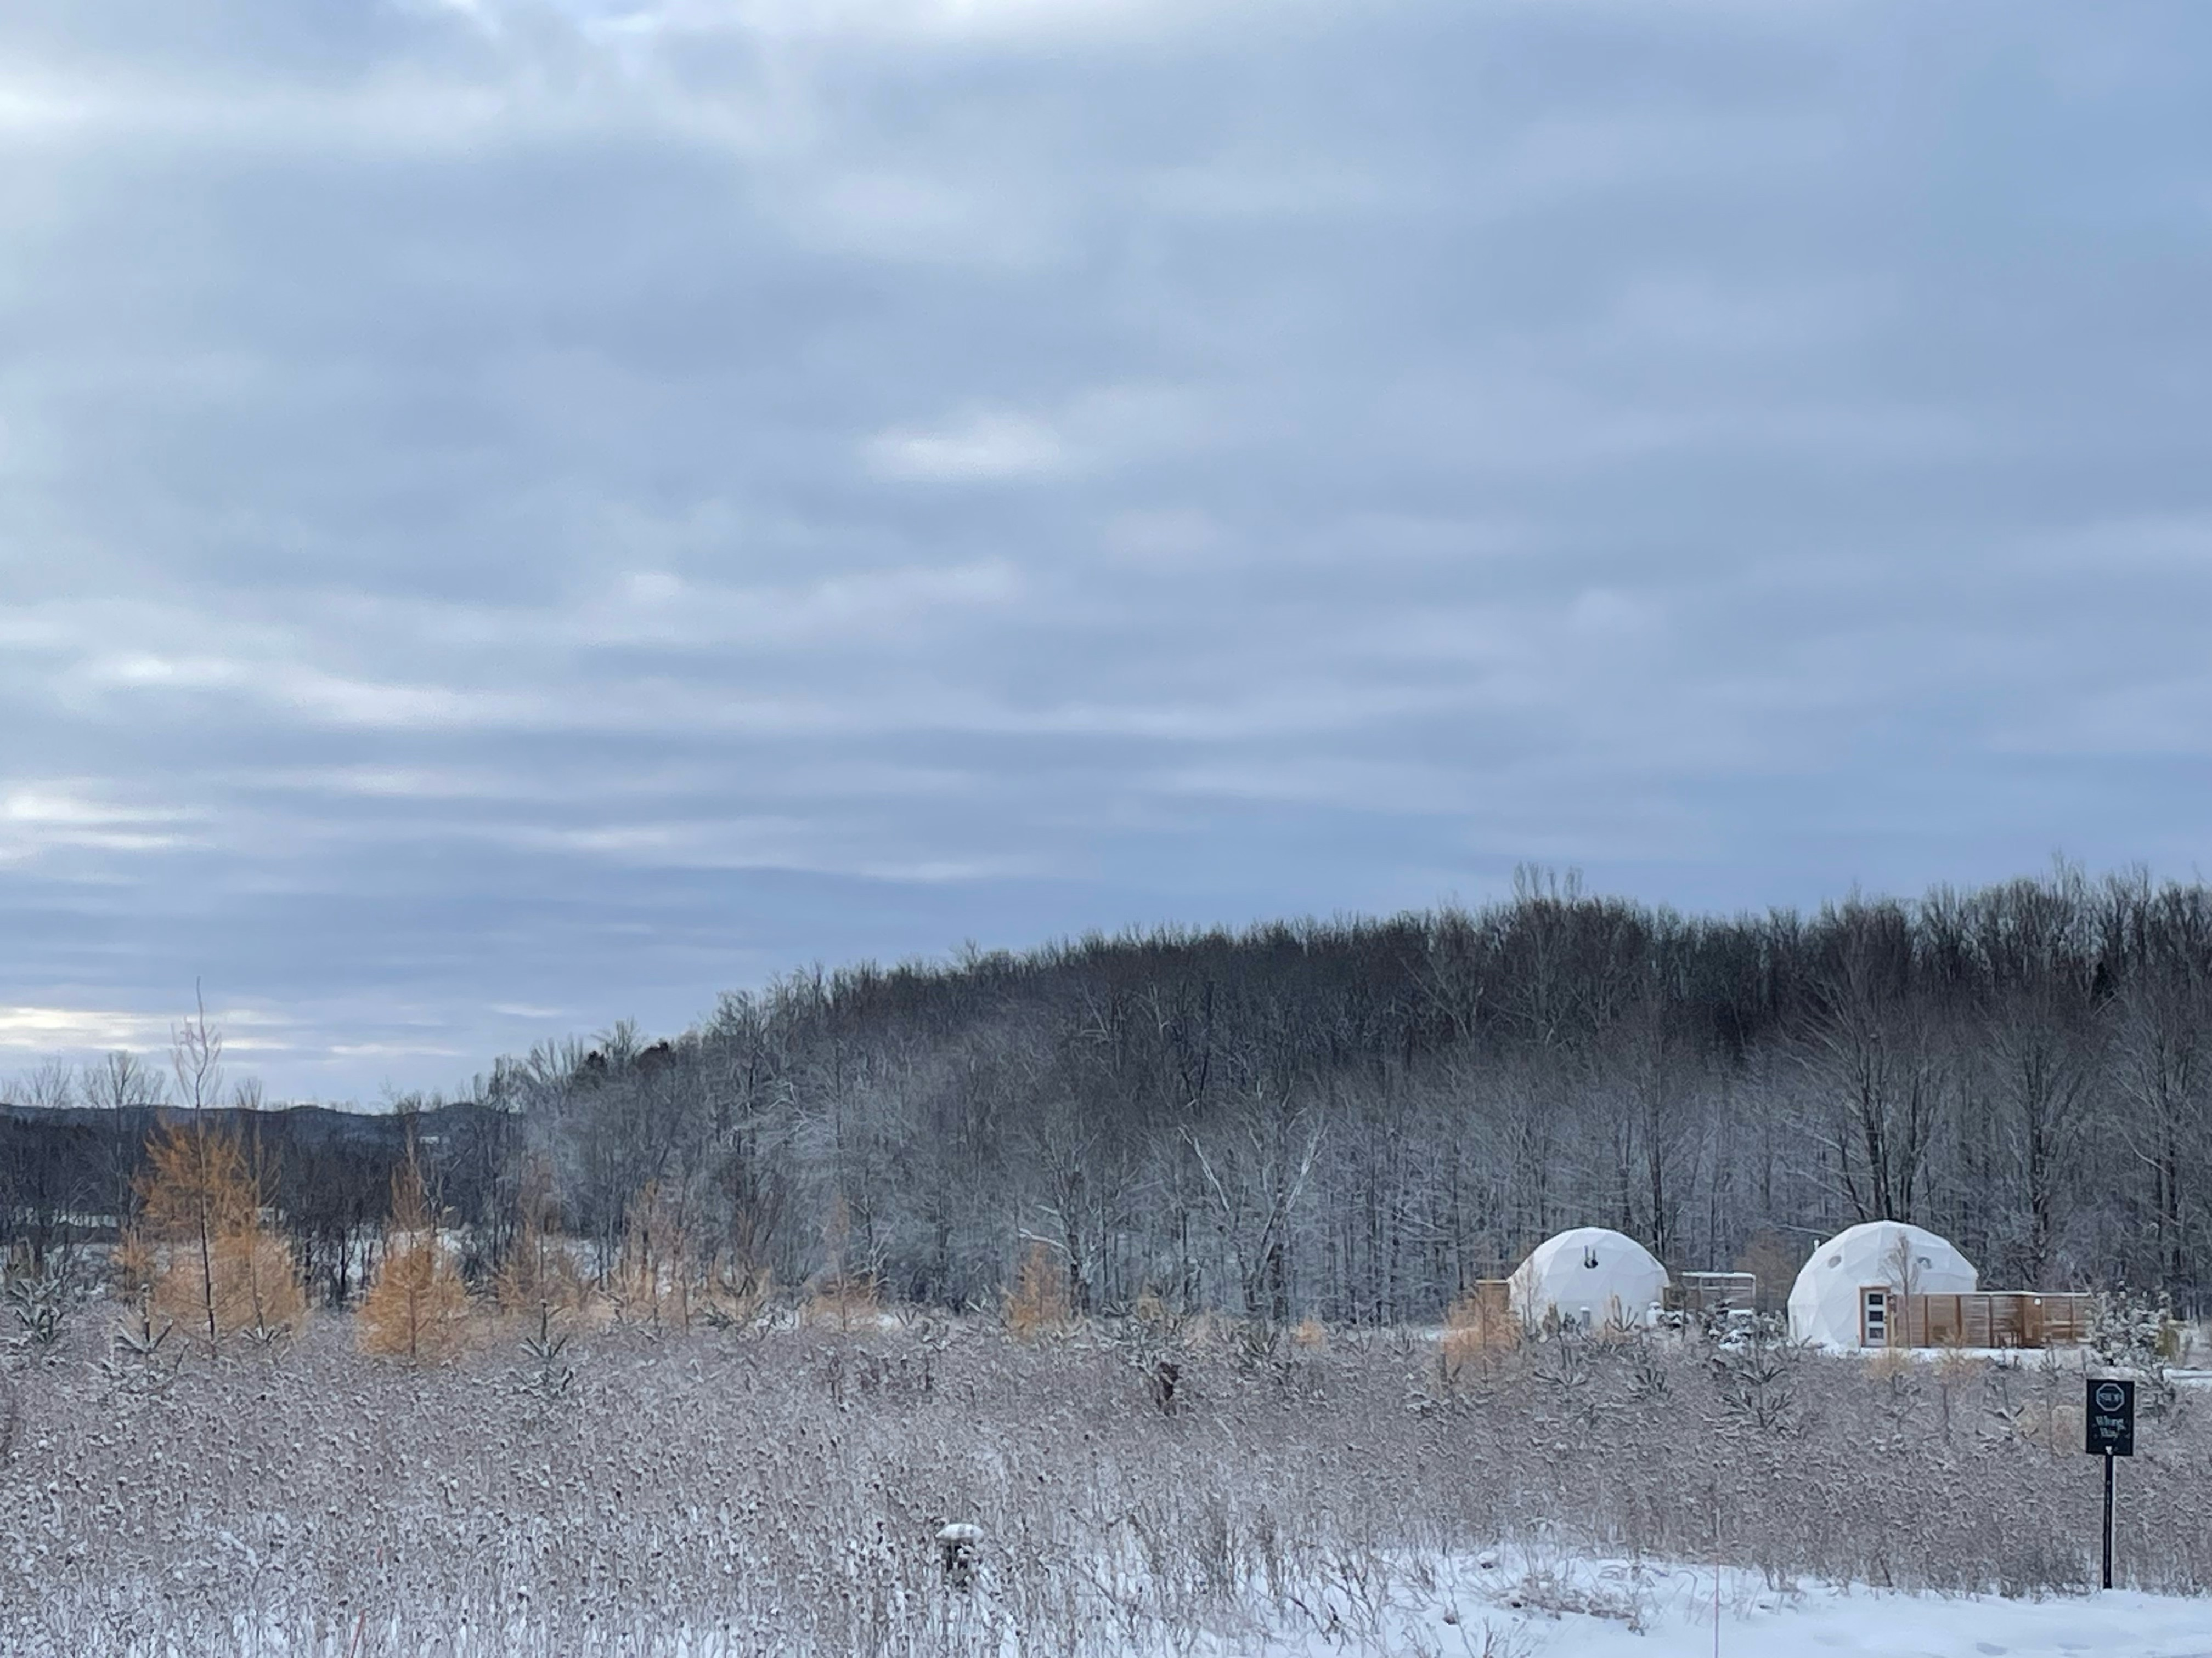
For financial prosperity
Final Takeaways

Slide 31
Final takeaways
Sustainable growth beats fast growth
Use debt strategically
Invest in efficiency
Build your team gradually and intentionally
Create memorable customer experiences

Slide 32

Share your next steps!
Thank you

